Slide 1


SDT in Diagnosis and Testing
Why, When, and How We Look for Signal (Day 2)
Mikołaj Wieczór, M.A.
Faculty of Psychology and Cognitive Science, AMU Poznan

Slide 2
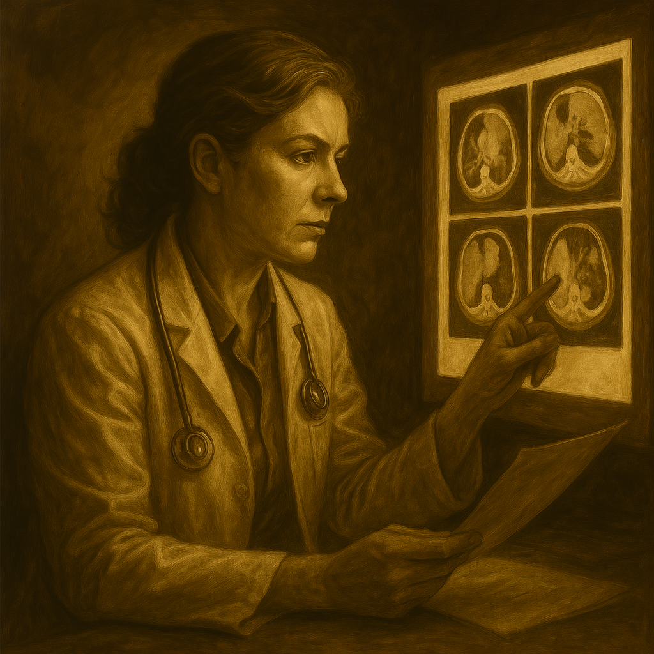
Story Time – Dr. Jones, Radiologist
“Meet Dr. Jones, a radiologist with over 15 years of experience. Every day she reviews CT scans for signs of abnormalities in tissues and organs. She knows that not every variation from textbook ‘normal’ is harmful—some deviations are benign, unique to each patient. Others can signal serious disease requiring immediate surgery or medication.”
Key Questions:
How can Dr. Jones’s work be framed in SDT terms?
What factors influence her decision on each scan?
Where would we assign metrics like d′ and C?

Slide 3
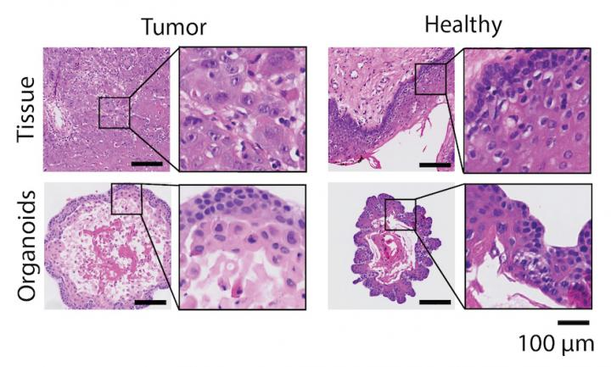
Organoids cultured from tumor and healthy tissue of a patient with head and neck cancer. Both the original tissue and the organoids are stained with hematoxylin (purple) and eosin (pink), a standard staining used in diagnostics. Tumor organoids look different than organoids cultured from healthy tissue and additionally retain characteristics of the original tumor tissue.
Else Driehuis, © Hubrecht Institute

Slide 4
Mapping Dr. Jones’s Decisions to SDT
SDT Concept | Radiologist Example
Signal = genuine pathology | True disease present on scan (tumor)
Noise = non-pathology | Benign variation or artifact (shadow)
Internal response = amount of „abnormality” observed | How suspicious a lesion looks (e.g. rated 1-5)
Criterion (C) = threshold to call ‘abnormal’ | Cut-off: Only call abnormal if rating ≥ 4
Discriminability (d’) = ability to tell pathology from non-pathology | Professional training, years of experience, good vision
Question: What might push Dr. Jones to shift her criterion conservatively or liberally?

Slide 5


SDT Outcomes in Medical Terms
 | Disease Present | Disease Absent
Called ‘Abnormal’ | True Positive (TP) | False Positive (FP)
Called ‘Normal’ | False Negative (FN) | True Negative (TN)
• TP = correct identification of true disease
• FN = missed real pathology (dangerous)
• FP = benign change called ‘disease’ (unnecessary follow-up)
• TN = correctly identifies normal scan

Slide 6
Diagnostic Classification Systems (ICD, DSM) as SDT
ICD/DSM define thresholds for diagnostic categories (e.g., depression, PTSD).
Each criterion set serves as a decision boundary (“Does patient have disorder X?”).
‘Signal’ = patient truly has disorder; ‘Noise’ = normal variations in mood/behavior.
Any classification system has inherent discriminability (d′) and bias (criterion).
Example:
DSM-5 criteria for Major Depression require ≥ 5 of 9 symptoms. Some clinicians might use ≥ 6 symptoms to reduce false positives.

Slide 7
Sensitivity, Specificity, and Accuracy – Definitions
Sensitivity (True Positive Rate) = TP / (TP + FN): Proportion of actual disease correctly detected.
Specificity (True Negative Rate) = TN / (TN + FP): Proportion of healthy cases correctly identified.
Accuracy = (TP + TN) / Total trials: Overall correctness, but dependent on prevalence.
Example:
100 diseased → 90 TP, 10 FN → Sensitivity = 0.90
200 healthy → 180 TN, 20 FP → Specificity = 0.90
Total correct = 270/300 = 0.90.

Slide 8
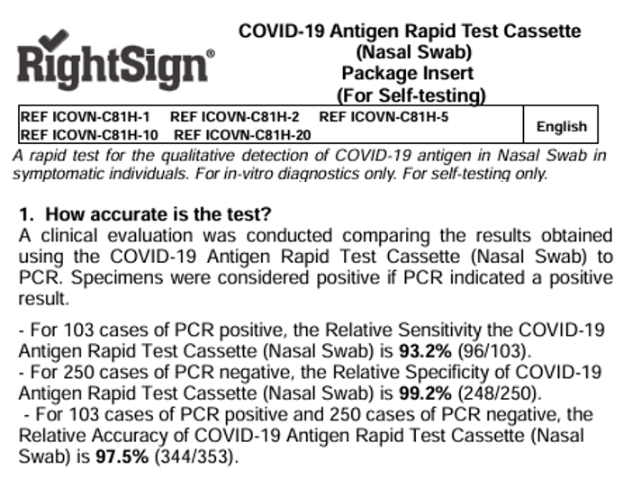
COVID‑19 Self‑Test
Claimed Sensitivity: 93,2% (detects 93,2% of infected).
Claimed Specificity: 99,2% (identifies 99,2% of uninfected).
Scenario: 353 people → 103 infected, 250 healthy:
TP=96,
FN=7;
TN=248,
FP=2;
Accuracy=97,5%.
Count it yourself in worksheet →

Slide 9
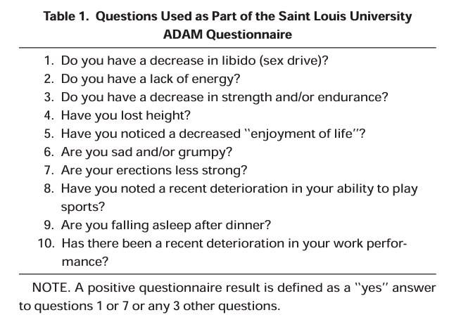
ADAM Questionnaire Validation (Morley et al, 2000)
Study Context: ADAM is a screening tool for Androgen Deficiency in Aging Males (Morley et al, 2000).
Validation Study: 316 men completed ADAM; all of them provided blood samples for testosterone measurement (gold standard).
Results: 25% of all subjects had low testosterone. The criteria for a positive questionnaire result identified 88% of men with low testosterone (sensitivity) with a specificity of 60%.
What about counting it other way around? → worksheet

Slide 10
Linda & Bob problems
Linda is 31 years old, single, outspoken, and very bright. She majored in philosophy. As a student she was deeply concerned with issues of discrimination and social justice and also participated in anti-nuclear demonstrations. She lives in a cooperative house called Women's Space. Which is more likely?
a) Linda is a bank teller.
b) Linda is a bank teller and a feminist.
At Central High School 10% of the seniors go on to college. Bob is a senior at Central High. He gets mostly As and Bs in school and is well liked by his teachers.
Which is more likely?
a) Bob will go to college.
b) Bob will not go to college.

Slide 11
Base Rates and Base‑Rate Neglect
Base Rate (Prevalence): proportion of trials where signal/disease is present (in population or in a sample).
Base‑Rate Neglect: ignoring prevalence when evaluating probability.
If we know that the signal we’re looking for is rare, we should be cautious in claiming that there was indeed signal.
A low prevalence can challenge even highly accurate test in detecting a signal.
+
-
+
+
-
+
+
-
-
-
-
+
+
+
-
+
+
-
-
-
+
-
-
-
+
+
-
-
+
Population 1
Population 2

Slide 12
Base Rates and Base‑Rate Neglect
Test with:
80% sensitivity
50% specificity
+
-
+
+
-
+
+
-
-
-
-
+
+
+
-
+
+
-
-
+
-
-
-
+
+
-
-
+
-
Population 1
Positives = 10
Negatives = 4
TP = 8
FN = 2
TN = 2
FP = 2
Population 2
Positives = 4
Negatives = 10
TP = 3
FN = 1
TN = 5
FP = 5

Slide 13
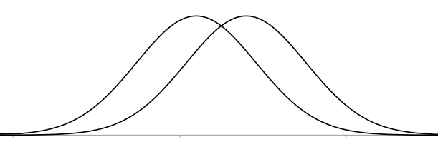
Adjusting Criterion for Base Rate
If something (e.g. disease) is rare: set a conservative criterion (higher C) to avoid false alarms.
If something (e.g. disease) is common: set a liberal criterion (lower C) to avoid misses.
Where to place threshold if disease affects 0.1% vs 20% of population? Why?

Slide 14
Positive Predictive Value (PPV) & Negative Predictive Value (NPV)
PPV = TP / (TP + FP): Probability a ‘positive’ is truly positive.
NPV = TN / (TN + FN): Probability a ‘negative’ is truly negative.
PPV and NPV depend on prevalence (base rate of signal to noise); they change even if sensitivity/specificity are constant.
Let’s check this out in worksheet →

Slide 15

Why Not Test Everyone for Everything?
Resource Constraints: Time, money, and personnel limit mass testing, especially at low prevalence.
False Positive Burden: Low prevalence + high specificity still yields many FPs → unnecessary follow-ups.
Psychological & Ethical Costs: Anxiety, invasive procedures, overdiagnosis.
Targeted Screening: Use risk factors, symptoms, or preliminary tests to decide who to test.

Slide 16
Wrap-Up & Key Takeaways
SDT in Medicine: Maps onto diagnostic decisions (TP, FP, TN, FN).
Prevalence Matters: Base rate influences criterion placement; ignoring it causes errors.
Beyond Sensitivity/Specificity: PPV and NPV show real-world predictive accuracy.
Practical Implications: Screening must balance resources and patient impact.
Next Steps: Tomorrow we explore SDT in legal/eyewitness contexts.

Slide 17
Discussion & Questions
Which metric (sensitivity, specificity, PPV, NPV) resonated most with your field?
How might you adjust criterion in your own research context?
Any lingering questions on base-rate effects or diagnostic metrics?

